Slide 1
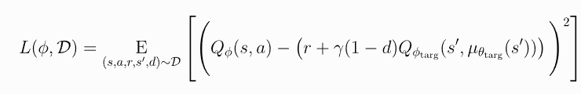
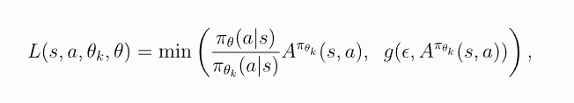
RL Algorithms
Deep Deterministic Policy Gradient (DDPG)
Proximal Policy Optimization (PPO)

Slide 2
Differences and Why We Switched
DDPG is an off-policy algorithm whereas PPO is an on-policy algorithm.
DDPG is very hyperparameter sensitive whereas PPO is less sensitive.
Failed to train DDPG from scratch and adapt to custom simulation even with several hyperparameter changes and time was running out

Slide 3
Training & Results
Trial 5 – Hallway (1 path)
1000 epochs
64x2 hidden
3e-4 Policy LR
Reward Function
Proximity reward (5)
Crash Penalty (-30)
Goal Reward (30)
Throttle Reward (1.1)
Steer Reward (0.5)
Non-zero average steer penalty

Slide 4
Training & Results (continued)
Trial 8 – Hallway (1 path)
200 epochs
64x2 hidden
3e-4 Policy LR
Reward Function
Proximity reward (1)
Crash Penalty (-2)
Goal Reward (30)
Throttle Reward (1.1)
Steer Reward (0.5)
Non-zero average steer penalty

Slide 5
Training & Results (final)
Trial 17 – Hallway (4 paths)
200 epochs
128x2 hidden
1e-4 Policy LR
Reward Function
Proximity reward (1)
Crash Penalty (-2)
Goal Reward (30)
Throttle Reward (1.1)
Steer Reward (0.5)
Non-zero average steer penalty

